Slide 1
3D Sphere

Slide 2
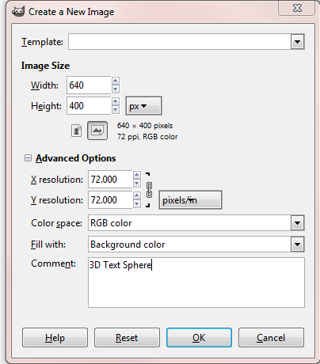
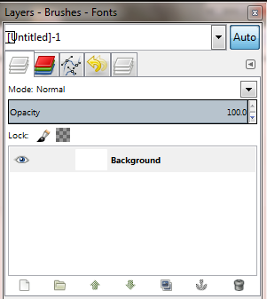
GIMP® is all about IT (Images and Text)
OPEN GIMP®
Step 1: To begin a new GIMP® project, from the Menu Bar, select File | New. At the Create a New Image dialog box, select a size and background color for your new image.
I selected 640 x 400 pixels with a white background.
You will need to click the + sign beside Advanced Options to expand the menu. In the Comment text box, describe the image. Click the OK button.
A new image canvas displays in the GIMP® workspace with image information in the Title Bar and a “Background” layer displays in the Layers palette to the right of the image window.

Slide 3
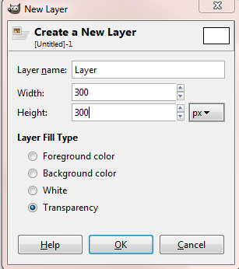
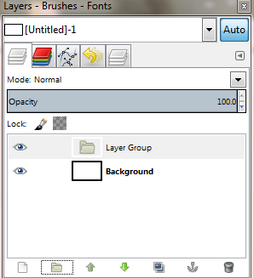
Click on the folder icon to create a new “Layer Group”
Next, click on add a “New Layer”
Change the width and height to 300px and click Ok.

Slide 4
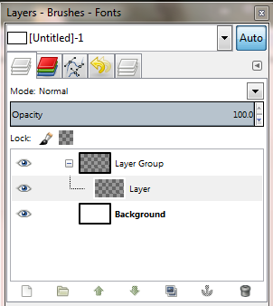
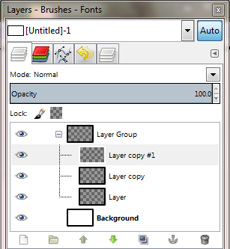
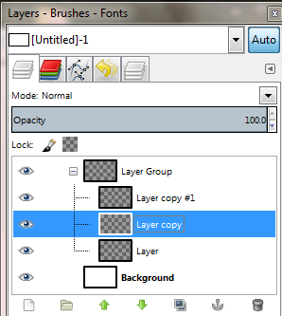
Now we need to duplicate this new layer twice.
Click on the “Duplicate Layer” button twice.
Now select the middle layer by clicking on it. This is the layer we are going to create our sphere shape on.

Slide 5
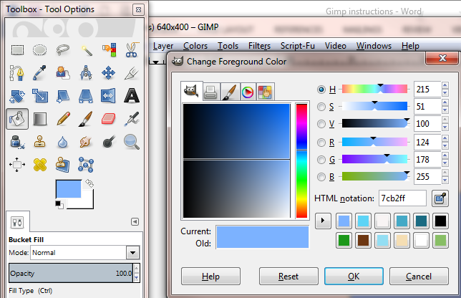
Next we are going to fill this layer with a color.
Click on the “Bucket Fill Tool” and then the foreground color swatch.
Select the color you want to have for your first sphere and click ok.
Click on the layer to fill it with color

Slide 6
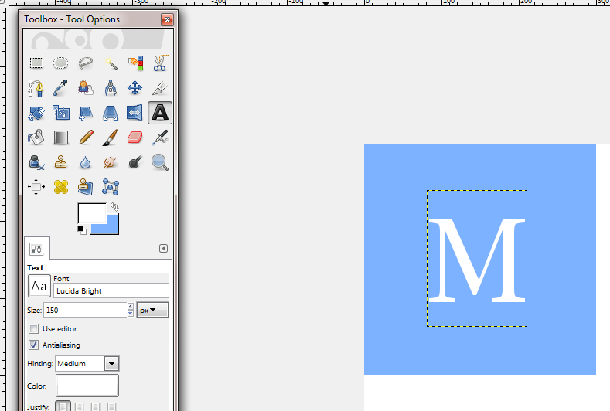
Now we need to add text, one letter to be precise.
Click on the “Text Tool”. Click on the switch arrows to change the Foreground to White, select a font of your choice, and then change the size to 150px.
Click on the Layer and type the letter “M”.
Then Select the move tool to position the M in the middle of the square.
Remember that when you use the Move Tool – you will want to select the Move the active layer option in the Move tools

Slide 7
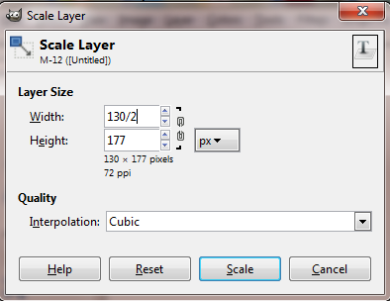
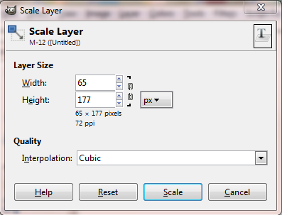
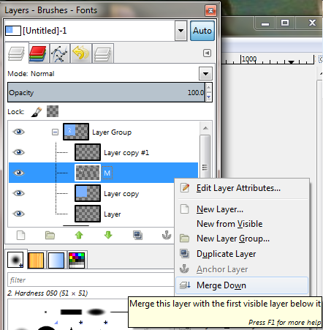
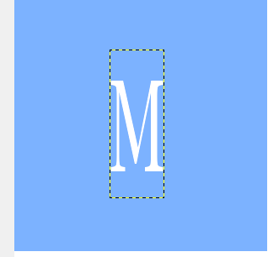
Now we need to scale the layer to that the text doesn’t wrap when we change it to a sphere.
Click on Layer – Scale Layer in the toolbar.
Since we only want to change the width , click on the chain to Unlink it.
Then you can divide the width by putting “ /2” right in the cell. Click Scale.
Notice your M is now skinnier, but it will stretch around the sphere.
In the layers panel, right click on the M and select Merge Down onto the colored layer.

Slide 8
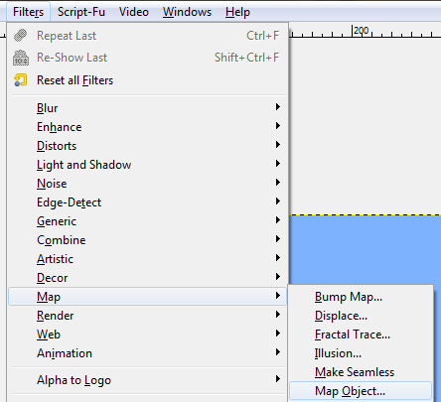
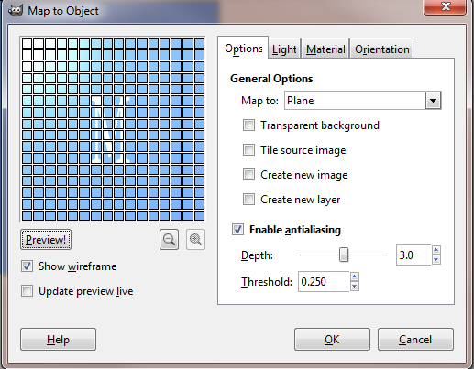
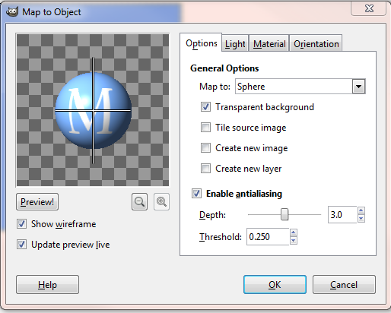
From the toolbar click on Filters – Map – Map Object.
Options:
Change “Map to” from Plane to Sphere.
Check off - transparent background
Check off - Update live preview

Slide 9
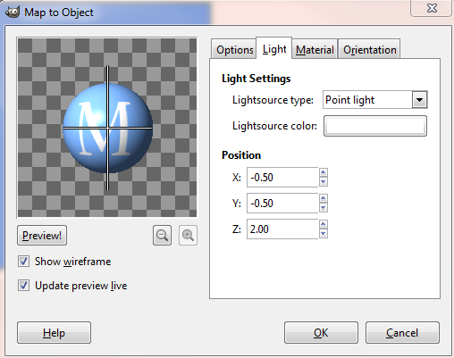
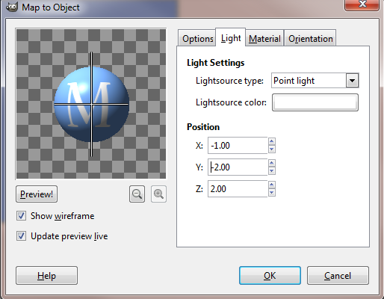
Light:
Change X to -1.00
Change Y to -2.00
Note: you can change these to anything you would like, adjust them and watch what happens in the live preview.

Slide 10
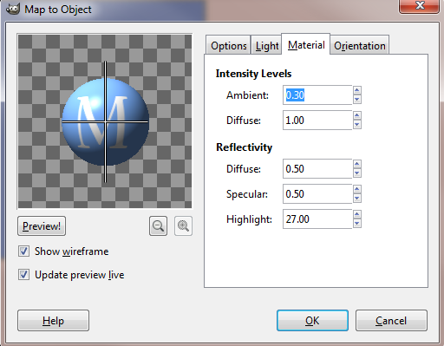
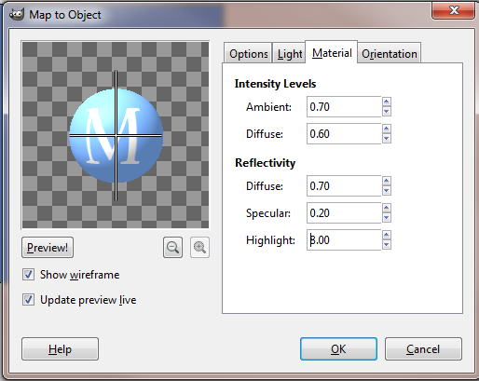
Material:
Intensity Levels
Ambient to .70
Diffuse to .60
Reflectivity
Diffuse to .70
Specular to .20
Highlight to 8.00
Note: as before, adjust them and watch what happens n the live preview.

Slide 11
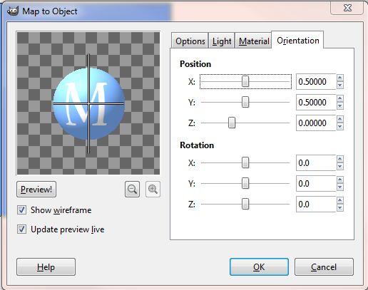
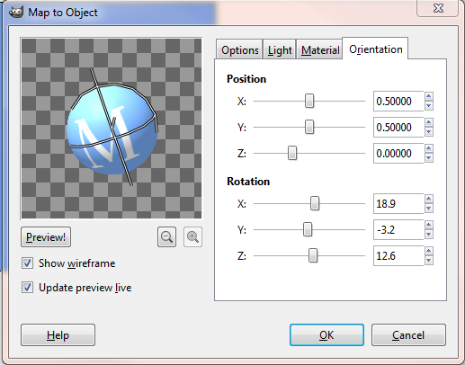
Orientation:
Change the rotation to however you would like.
You should make each letter rotate or face a different way.
When you are done. Click OK.
If you don’t like the final look you can go up to the toolbar and click on Edit – Undo Map Object.. Then go back and click on Filter - Map- Map Object and make changes.

Slide 12
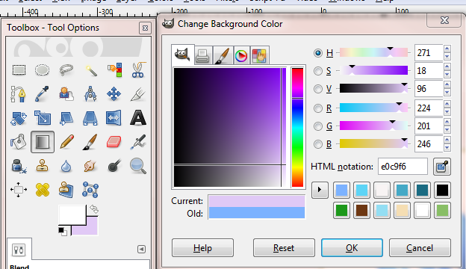
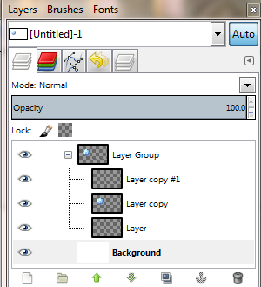
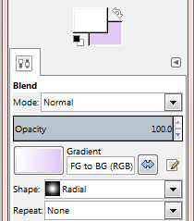
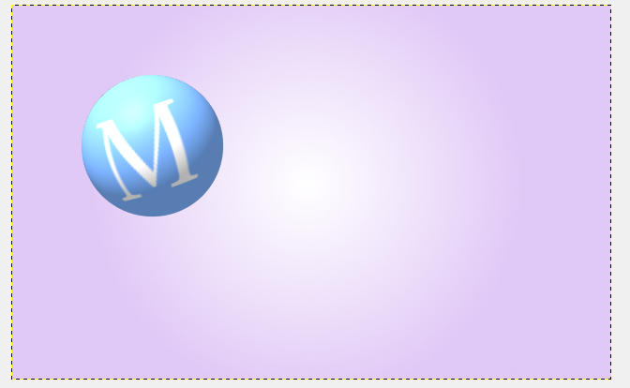
Now let’s add a background color, click on the background layer then select the Blend Tool.
Leave the foreground color at white and change the background color to a light purple and click ok.
Make sure the gradient is FG to BG and change the shape to radial.
Click in the middle of the background then drag the line to one of the corners. If it ends up being to light you can change your color to a darker color or only drag your line halfway to the corner.
In this I found dragging all the way to the corner way gave me too much white in the middle, so I only dragged half way.

Slide 13
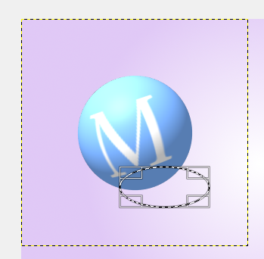
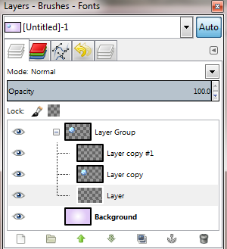
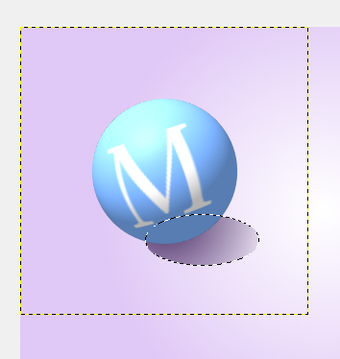
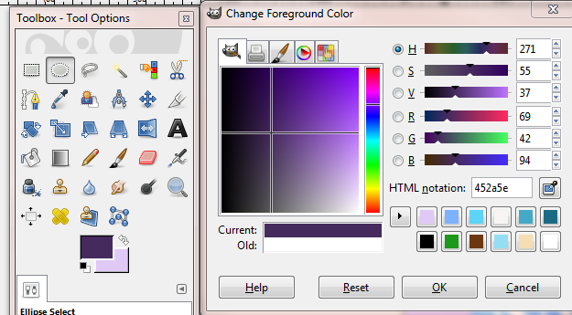
Adding a shadow to your sphere.
Click on the bottom layer
Then click on your Ellipse tool and make a shape below the sphere.
Click on the foreground and choose a darker version of what you have for the background.
Then click on the blend tool and change it from Foreground to Transparent, keep it at radial.
Drag from the base of the M out past the eclipse to add a small shadow.
Click the rectangle select tool and click outside of the canvas to turn off the current selection.

Slide 14
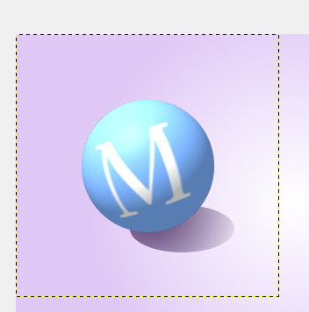
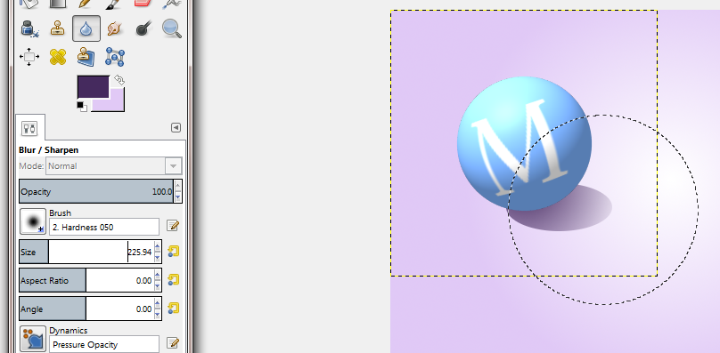
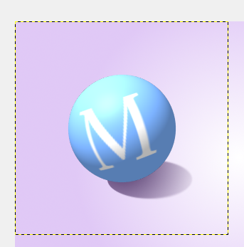
Add a blur to soften the shadow edges.
Click on the Blur Tool keep the brush the as default , but change the size to a little over 200. Drag the middle of the circle around the edges and the shadow to soften it.

Slide 15
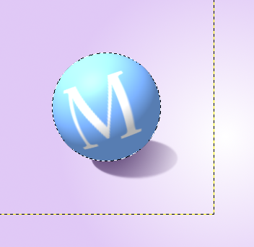
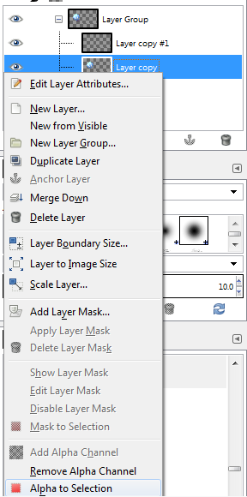
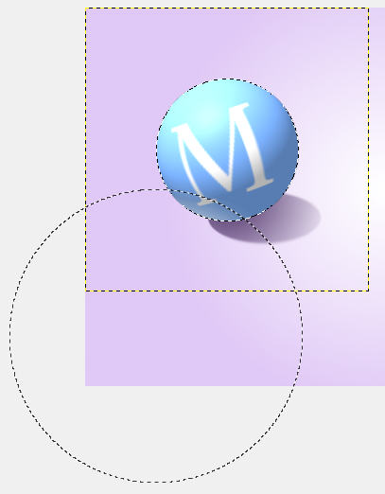
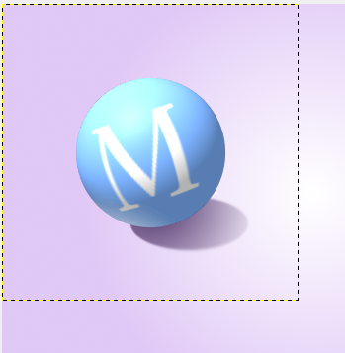
Adding a highlight:
Right click on the middle layer and chose Alpha to Selection. Next select the layer#1 copy , this is the layer we are actually adding the highlight to.
Click the paint brush tool. Make sure the foreground color is white and increase the size to above 300px.
Use the edge of the big brush, and click the mouse several times until you get the right amount of highlight that you would like.
When done, click on the rectangle tool and click outside of the canvas.

Slide 16
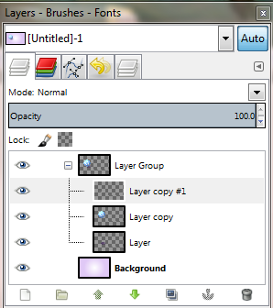
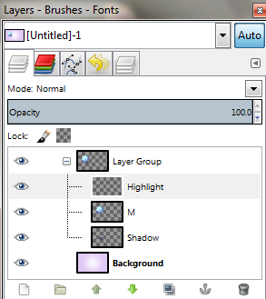
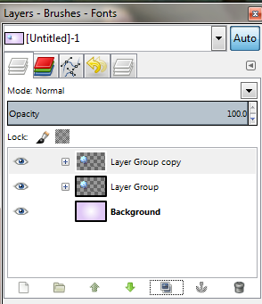
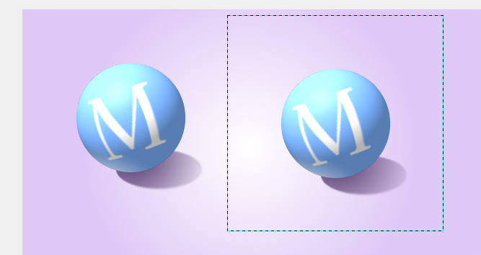
Creating your next letter.
First let’s label what we have.
Re-name “Layer” to Shadow, “Layer Copy” to M, and “Layer copy#1” to Highlight.
Next Close the layer Group, click on it to select it, then click on the Duplicate button to copy it.
Then Click on the Move tool and drag the M to the right, you now have two.

Slide 17
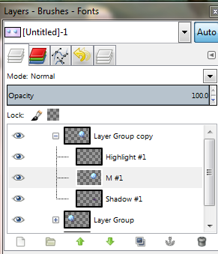
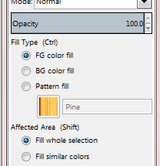
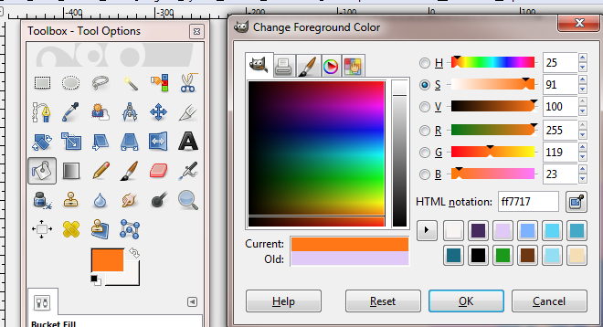
Because we have the group we will not need to recreate every step, just the new letter and mapping it to a sphere.
So to create our next letter.
Click on the Layer Group Copy and expand it. Then select the M#1 layer.
Click on the bucket fill tool and change your foreground color to what you want for the second sphere, click on Fill Whole Selection, Ok then click on the second M to fill it.

Slide 18
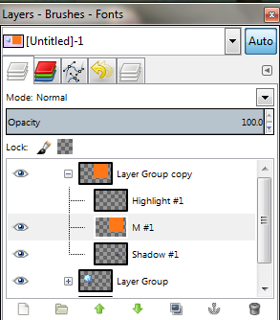
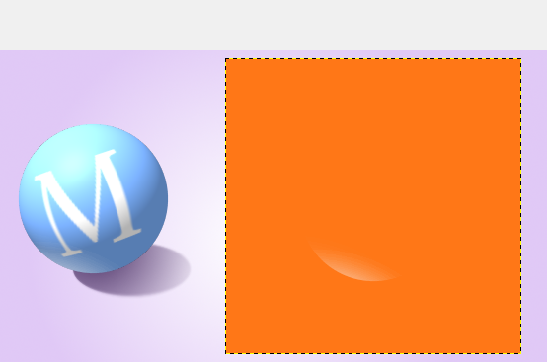
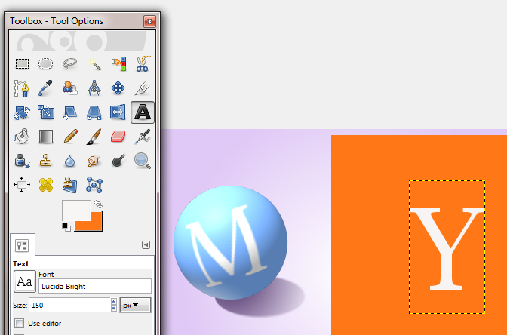
To hide the highlight , click on the eye to make it invisible.
Set the foreground color back to White and click the Text tool to create your Next Letter.. .Y.
Click on the Move Tool to place it in the middle of the square.

Slide 19
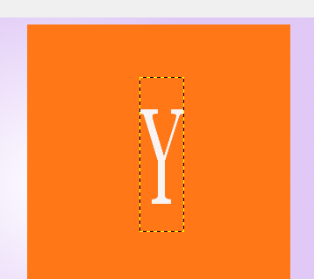
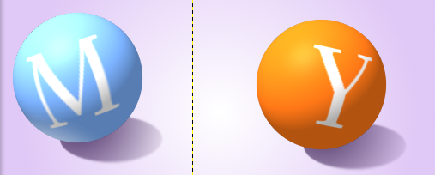
Next we need to shrink the letter by half again, so click Layer on the toolbar and select Scale Layer. Unlink the chain and divide the width by 2. Then Merge the Y text onto the color layer.
Now you can go up to Filter – you can click on Recently Used - Map Object.
When the dialog box open click on Orientation and change the Rotation then click OK.
Remember if you don’t like it, you can undo and make changes.
Don’t Forget to Turn your highlight back on!!

Slide 20
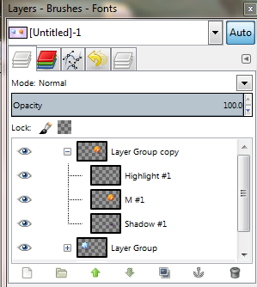
Lets clean up our layers and then I’ll show you a couple more options and the finished product.
In Layer Group Copy change the middle layer that holds the letter and color to Y and change the Group to Y.
Then go back and change the first Group to M.
Now remember to create another letter, you simply copy the group and follow the previous stapes for coloring the box , adding the letter, and mapping the object. ☺
I’m going to create four more letters to spell out GIMP.

Slide 21
Perspective
We perceive objects that are closer = larger and further away = smaller.
If I want MY in the upper left corner it should be a little smaller since it is further away from me.
Select the M Group, click on Layer and Scale Layer . Keep the link as is and change it to 250px. Do the Same for the Y.

Slide 22
Position – in front or behind
If you move the Y next to the M it will cover it (in front), however if you want to move the Y behind the M. Click on the M in the Layers Panel then click the Up arrow and the Y will get behind the M.
For this version I decreased the size of the P increase the size of the I and turned off the shadow, left the M and G the same and finally changed the order until I got the effect of the I sitting on top of the GM with the P behind it.

Slide 23
Experiment however you like ☺
I’m going to use this in my final website banner.
Don’t forget to save the .xcf. and export to a .png.

